Slide 1
Cardano & Cardano Education
Crypto Hub Malta, September 2023

Slide 2

About myself
Dr. Lars Brünjes, Director of Education at IOG
PhD in Pure Mathematics from Regensburg University.
Postdoc at Cambridge University (UK).
40 years of programming experience.
Joined IOG November 2016.

Slide 3
Cardano

Slide 4

Using the Scientific Method

Slide 5
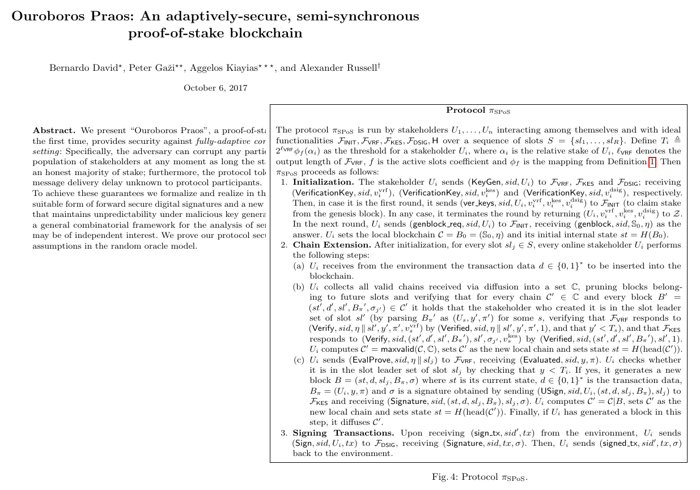
From Mathematical Paper...
Written in English.
Written by Mathematicians.
Very abstract.

Slide 6
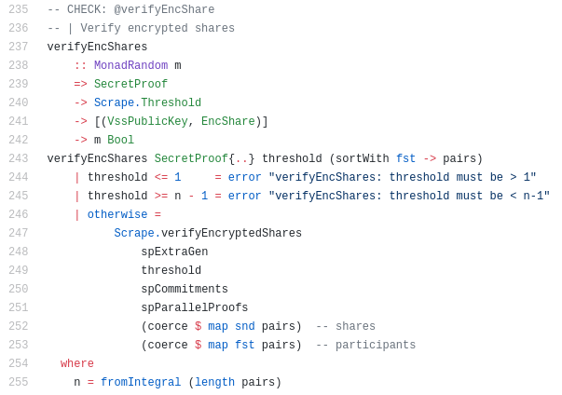
...To Efficient Code
Written in Haskell.
Written by Software Engineers.
Efficient code.

Slide 7
The Problem
We start from a mathematical paper written by mathematicians.
The paper will undergo rigid peer review and contain mathematical proofs of correctness.
The outcome should be correct and efficient Haskell code.
Our mathematicians don’t know Haskell, our engineers don’t know cryptography.
How can we guarantee we deploy code that faithfully implements the original paper?

Slide 8
The Solution: Formal Methods
Scientific Paper
High Level Implementation
First Refinement
“Implement” paper in high-level language (“Chi Calculus”).
Refine implementation, proving each step.
Arrive at efficient code.
Second Refinement
Efficient Code

Slide 9
Incentives

Slide 10
Desired Behavior
A solid majority of stake should be delegated to 1000 stake pools of equal size.
The stake pool operators should be online when needed.

Slide 11
Basic Idea
The rewards pool from one epoch (five days) is distributed amongst stake pools and individual protocol participants according to their stake.

Slide 12
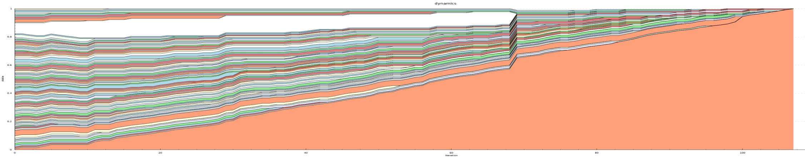
Problem with the Basic Idea
The basic idea is a good guideline, but too naive: The fewer pools there are, the lower total costs will be, the higher everybody’s rewards will be.
So the system will tend towards a single dictatorial pool that everybody else delegates to.

Slide 13
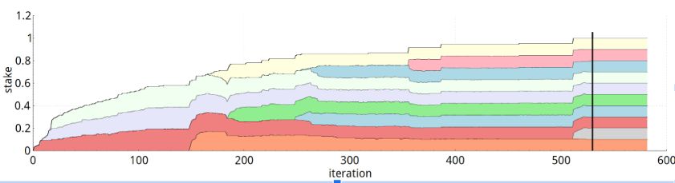
Refinements
Pool rewards are capped at 1‰ of available rewards.
Pools are penalized for not being online when it is their turn.
Pool leaders are compensated for their cost and effort by keeping a margin.
Pools increase rewards by pledging.
Pool members are rewarded proportional to the stake they delegated to the pool.

Slide 14
Cardano Education

Slide 15

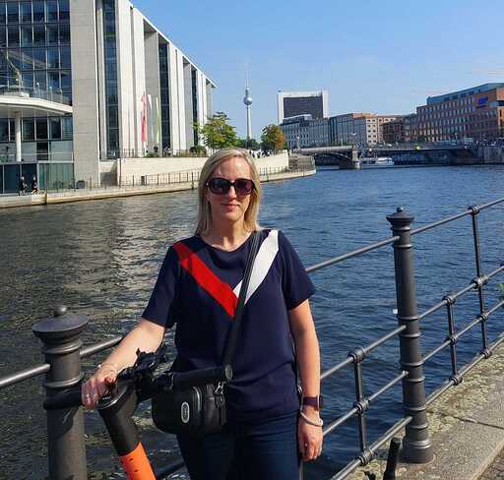
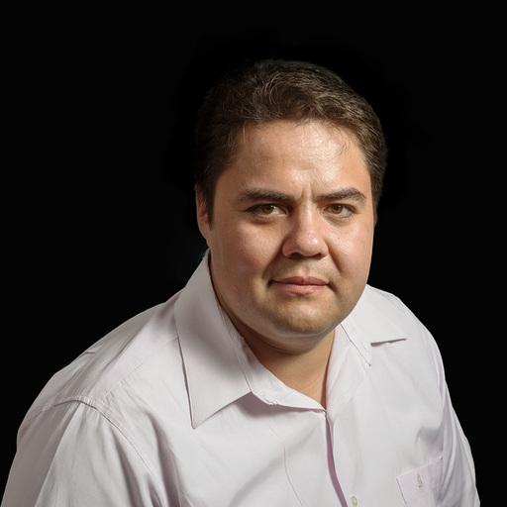
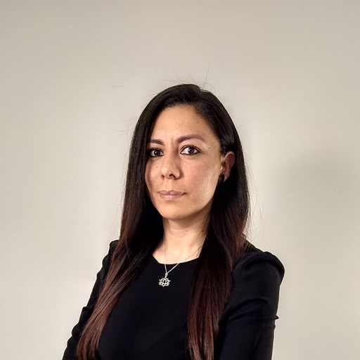
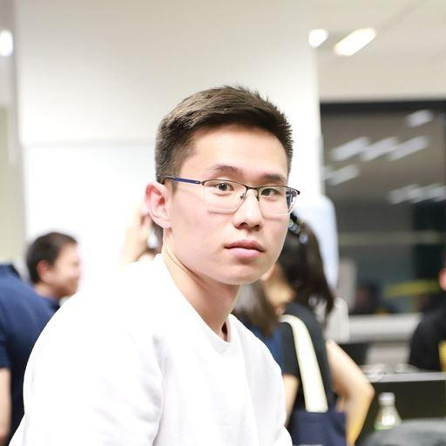
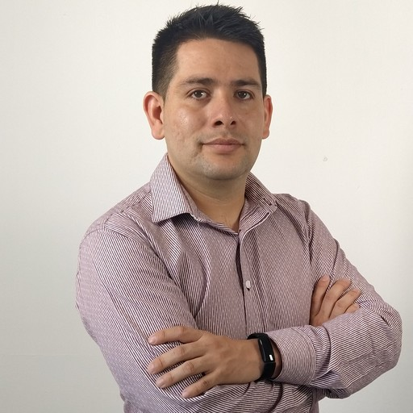
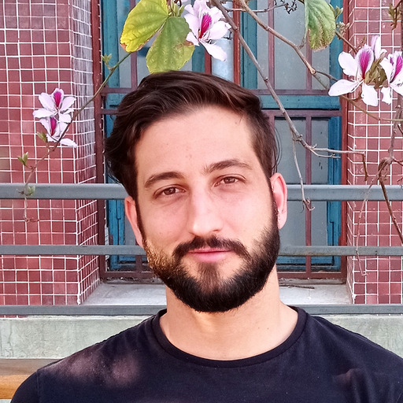
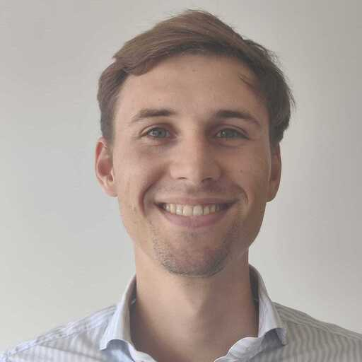
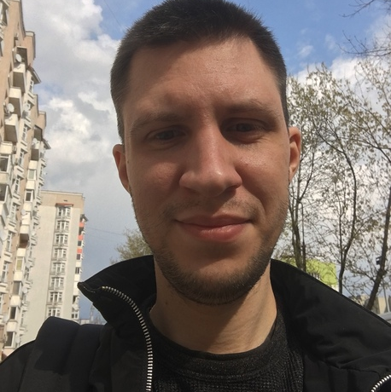
Our Team
Lars Brünjes
Niamh Ahern
Alejandro Garcia
Director of Education
Education Manager
Project Manager
Karina Lopez
Tuvshintsenguun Erdenejargal
Antonio Ibarra
Plutus Specialist
Plutus Specialist
Plutus Specialist
Robertino Martinez
Thomas Vellekoop
Alexey Sorokin
Education Assistant
Education Assistant
Education Assistant
‹#›

Slide 16
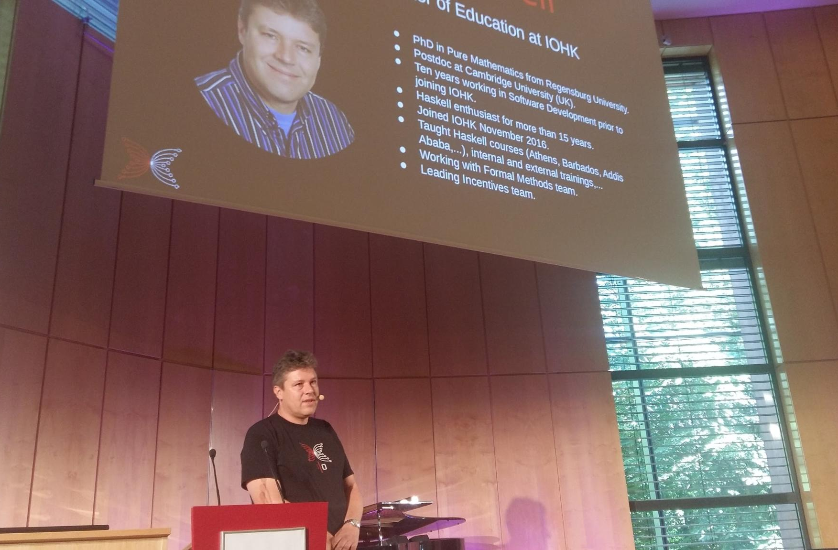
Conferences & Meetups
Meetups in Hamburg, London, Rotterdam, Zug, Tel Aviv, Malta, Ulaanbaatar, Buenos Aires…
Conferences in Hamburg, London, Basel…
Various interviews & podcasts.

Slide 17
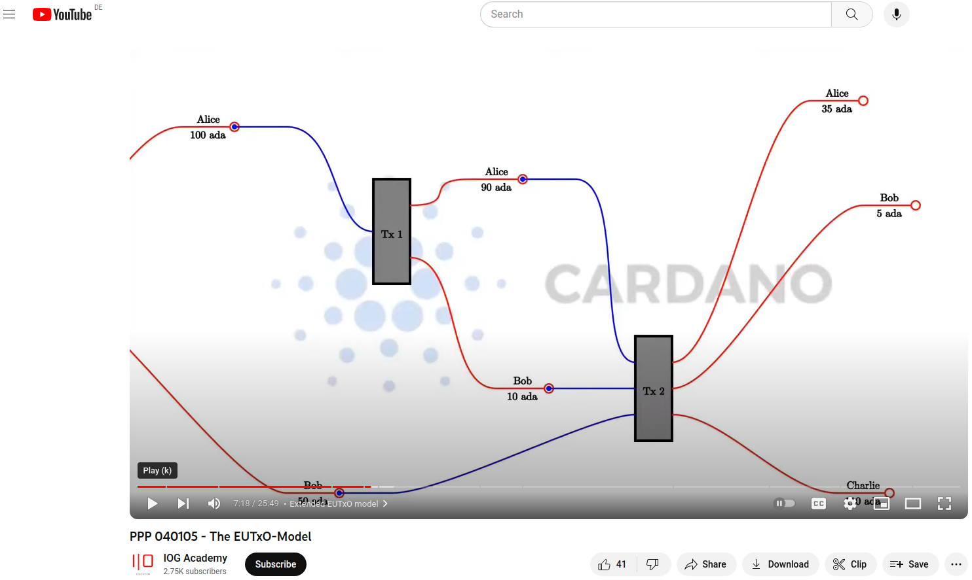
Plutus Pioneer Program
Freely available on YouTube & GitHub
Reaching thousands of students.
Recently completed iteration #4.

Slide 18
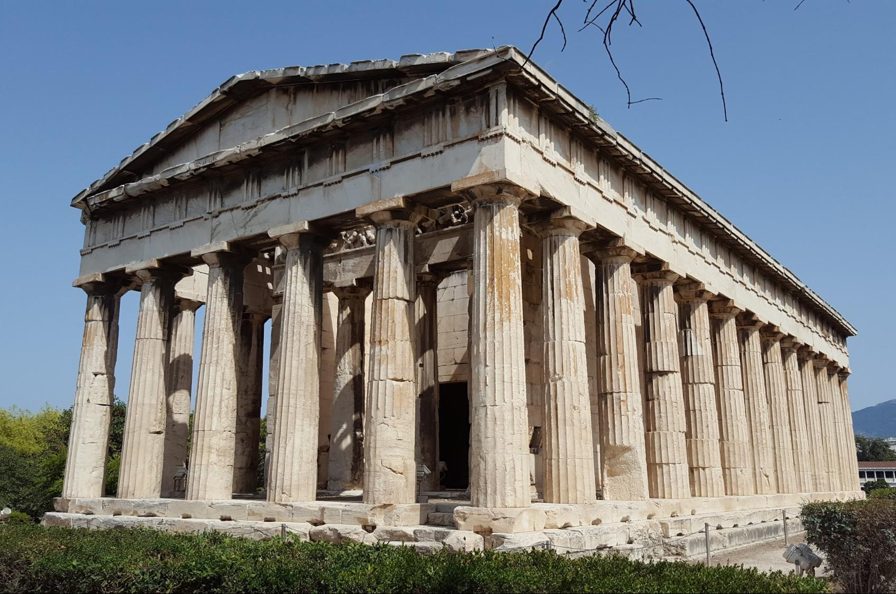
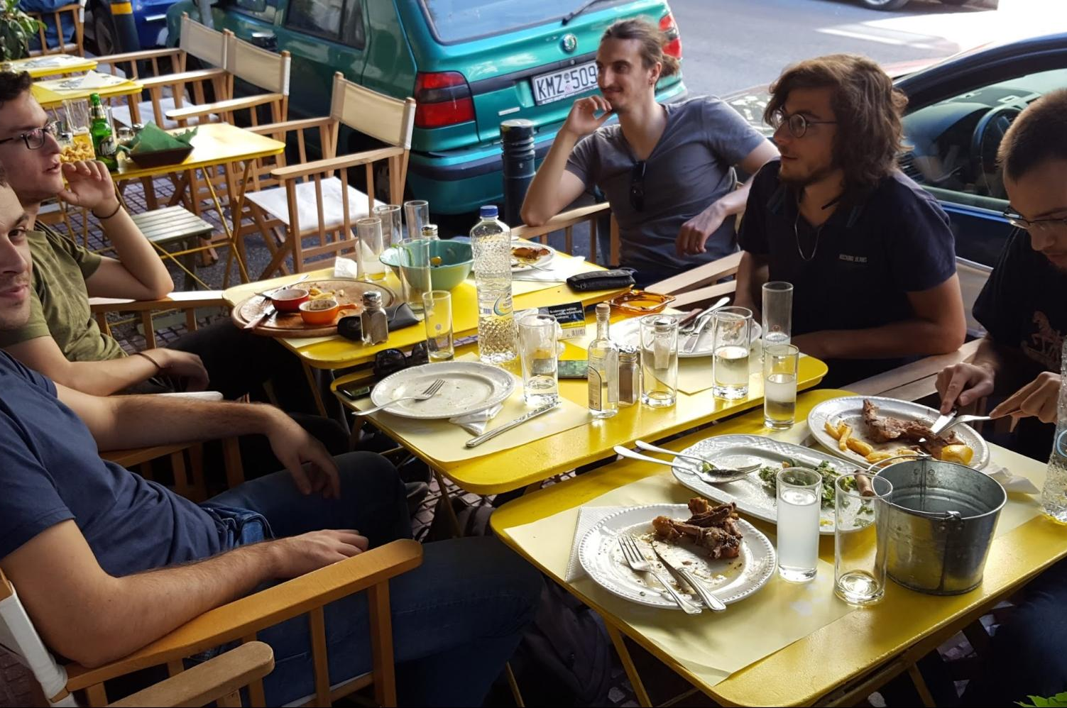
2017 - Athens, Greece
Seven students.
Hired most of them.

Slide 19
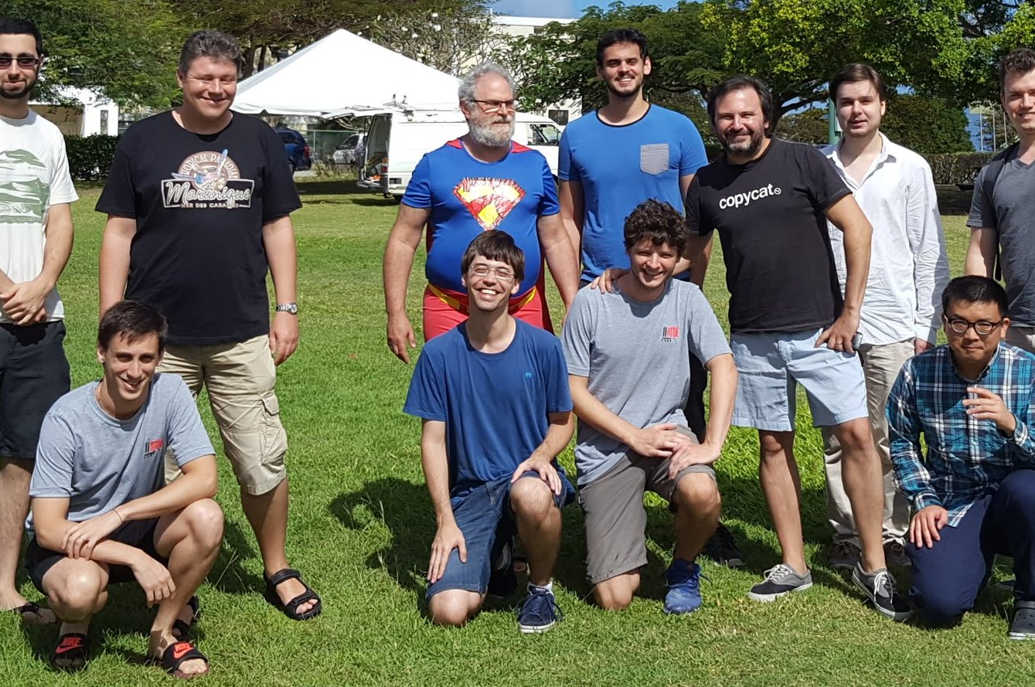
2018 - Barbados
Ten students, most of them IOHK employees.
Hired all external students.

Slide 20
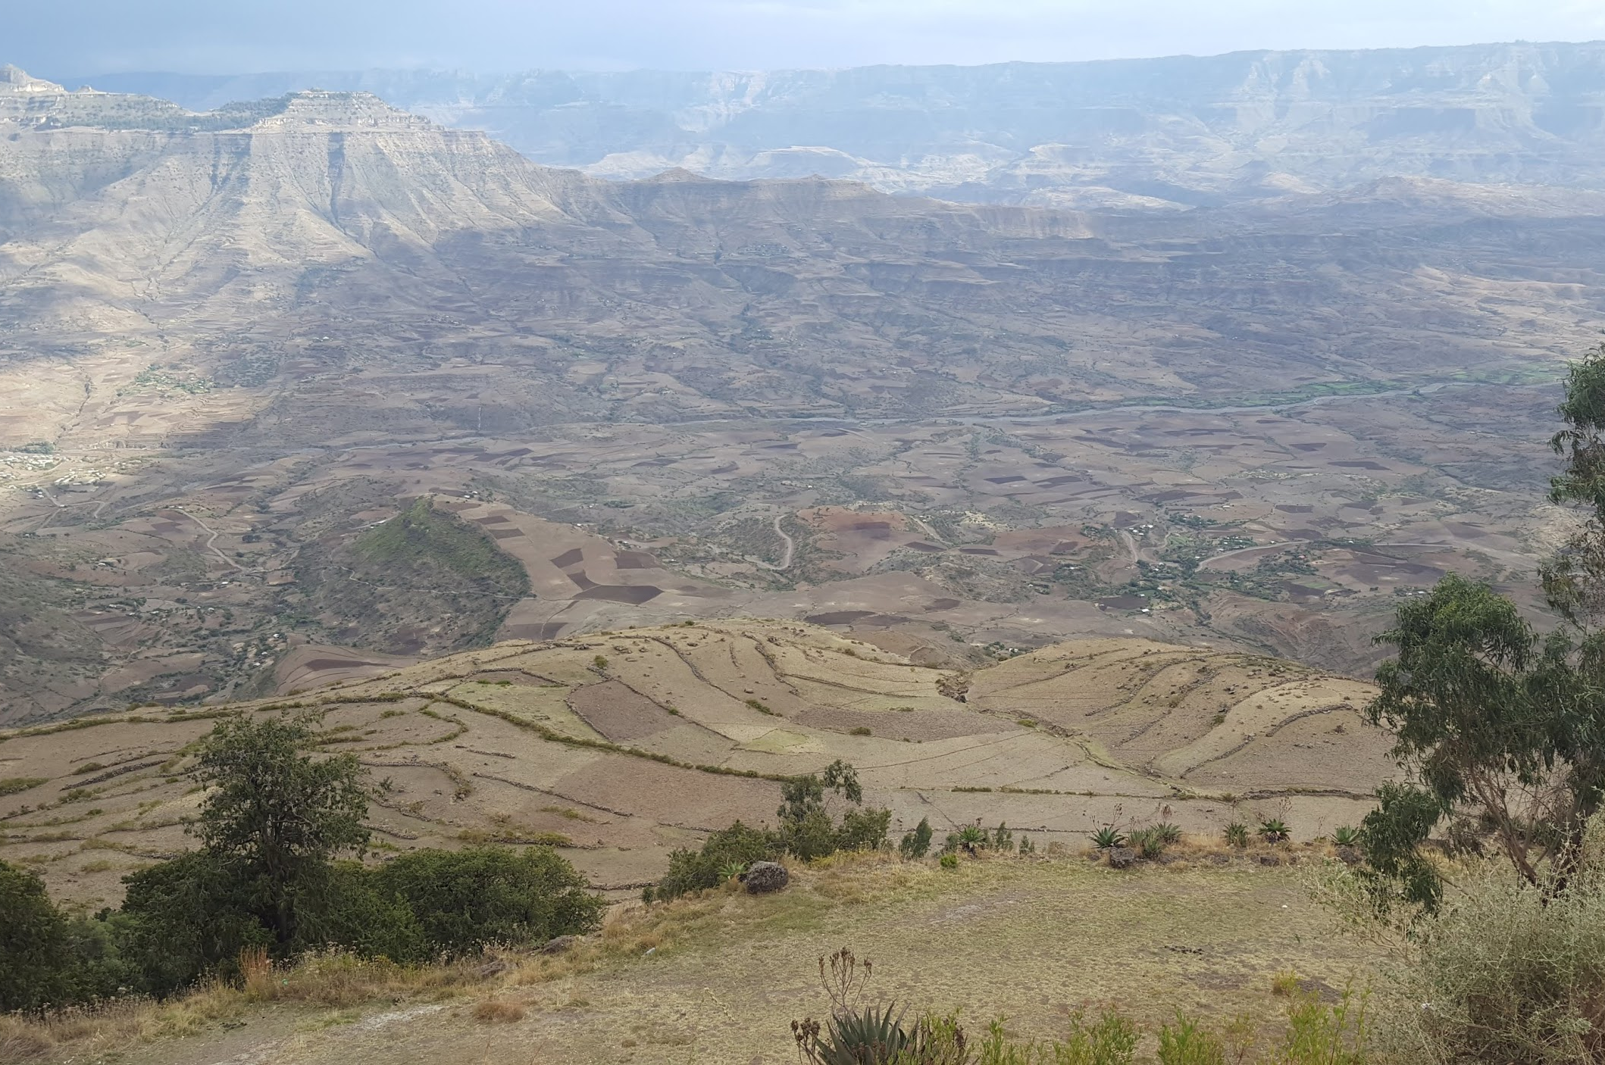
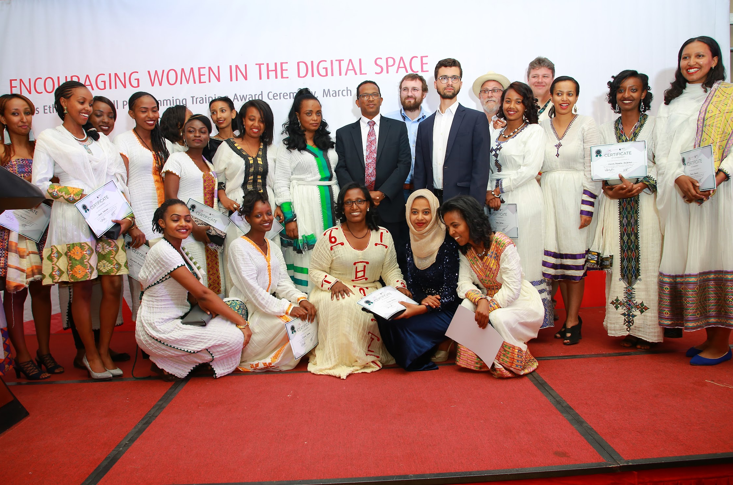
2019 - Addis Ababa, Ethiopia
22 students, 18 from Ethiopia, four from Uganda.
All women.
Made an offer to all of them.

Slide 21
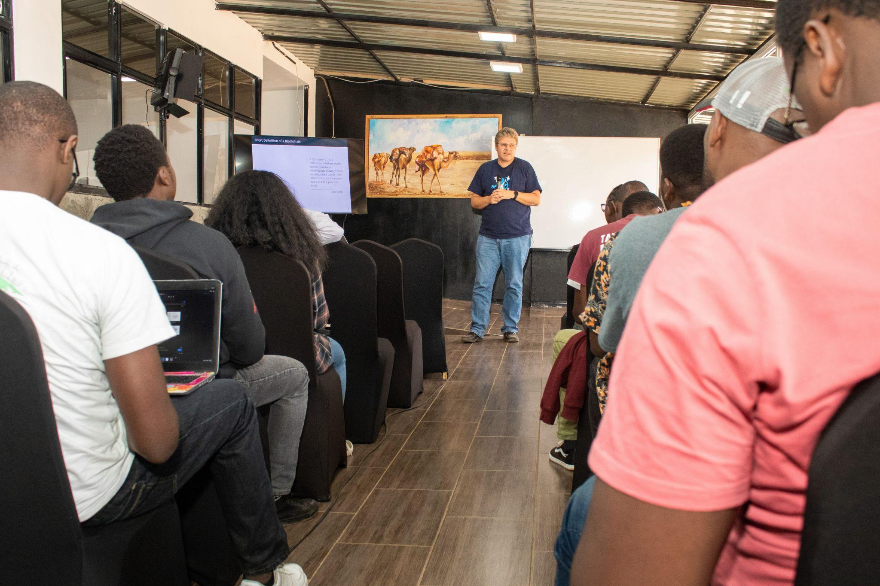
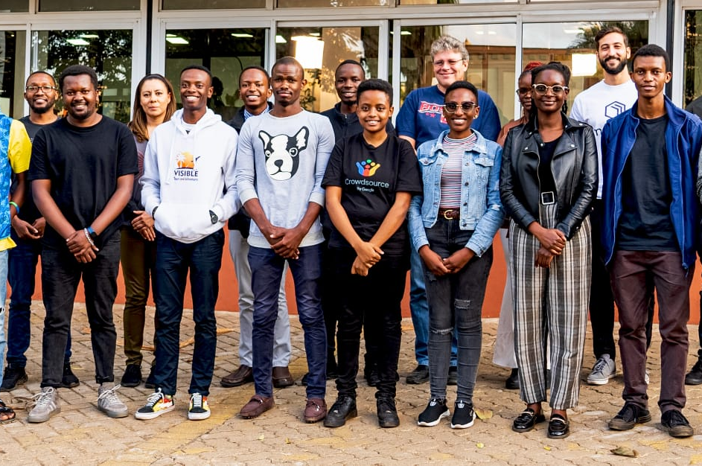
2023 - Nairobi, Kenya
Hybrid course - two weeks life in Nairobi, rest online.
Haskell, Marlowe & Plutus.
Collaboration with the African Blockchain Center.

Slide 22
Thank you

